Slide 1
BITS GenAI POCs
Insurance Chatbots for Customer Support
©2024 Benchmark IT Solutions. All rights reserved

Slide 2
Agenda-
1. Problem Statement
2. Technology used
3. Architecture Diagram
4. Solution brief
5. Output print screens
6. LangSmith Integration

Slide 3

1. Introduction & Problem Statement
The Insurance Chatbot for Customer Support is designed to assist customers with insurance-related queries efficiently and effectively. Leveraging advanced AI technologies such as Gemini-pro and Lang Chain to understand user messages and provide contextually relevant responses.
Problems :
Insurance companies often face high volumes of customer queries.
Traditional customer support can be slow and resource-intensive.
Customers seek immediate assistance for policy information , claim status, and common queries.
©2024 Benchmark IT Solutions. All rights reserved

Slide 4
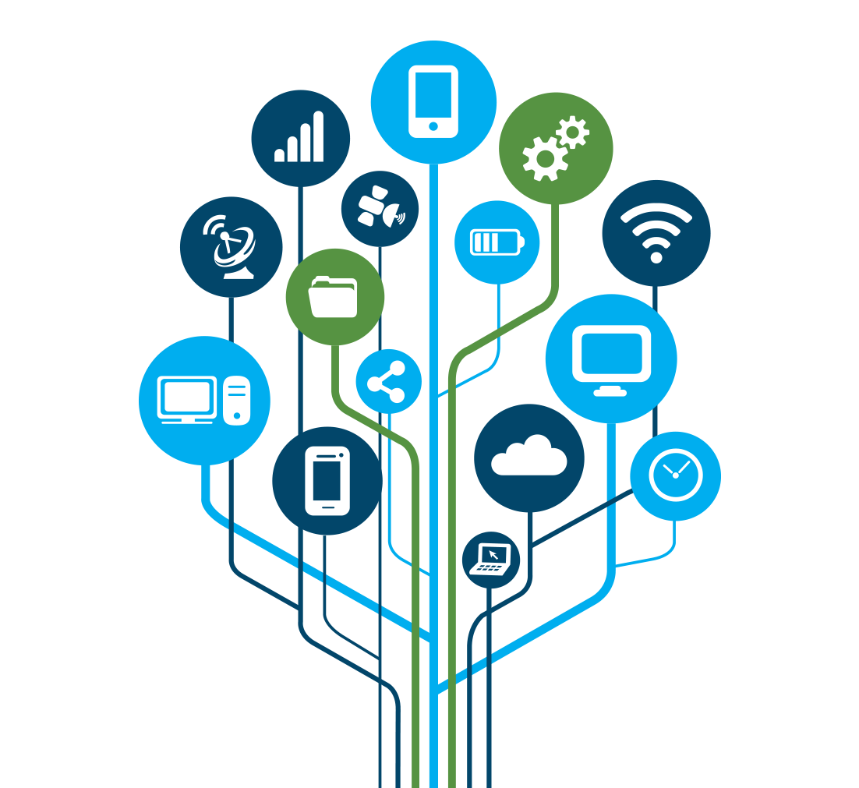
2. Technology
In this Chatbot Model I used tachylogias as below :
Streamlit: For building the web interface of the chatbot.
LangChain : For handling natural language processing and conversational AI.
PyPDF2 : For reading and extracting text from PDF documents.
PyTesseract : For Optical Character Recognition (OCR) to extract text from images and scanned documents.
FAISS : For fast similarity search of text embeddings.
Google Generative AI Embeddings : For converting text pieces into high-dimensional vectors.
LangSmith : For building, monitoring, debugging, and evaluating production-grade LLM applications.
©2024 Benchmark IT Solutions. All rights reserved

Slide 5
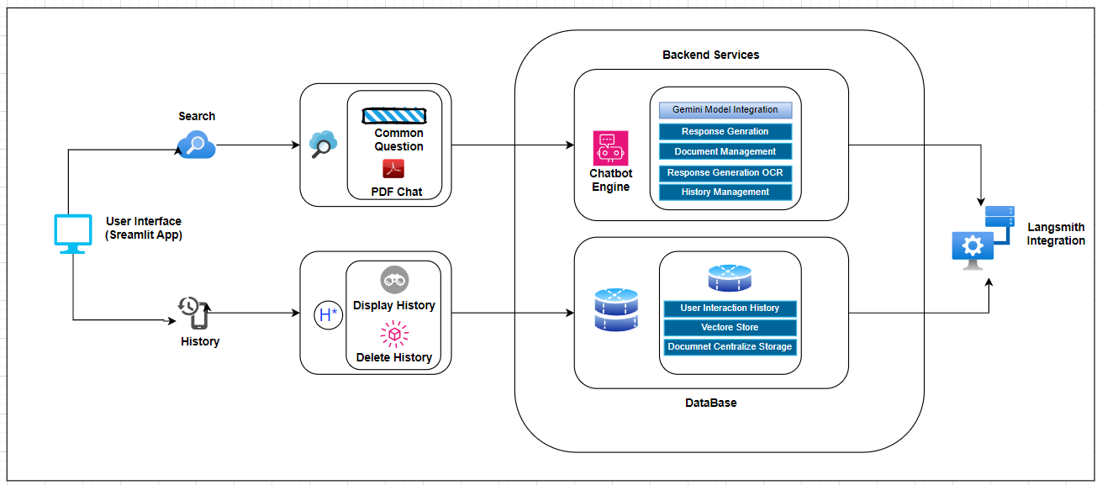
3. Architecture Diagram
©2024 Benchmark IT Solutions. All rights reserved

Slide 6
4. Solution brief
This chatbot is built using LangChain, Streamlit, PyTesseract, and the Gemini LLM API key. It is able to understand user queries and provide accurate answers. Additionally, it has the option to upload multiple PDFs and chat based on their content. Below are the features added in the model:
Feature :
PDF Document Upload:
Users can upload multiple PDF documents. The chatbot processes these documents, extracting text content to provide context.
Chat History Management:
The chatbot maintains a session-based chat history, allowing users to revisit previous conversations. Users can also clear the chat history to start a fresh session.
Cache Resources:
A cache is utilized to store frequently accessed data, improving the processing time and efficiency of the chatbot.
©2024 Benchmark IT Solutions. All rights reserved

Slide 7
Integration with OCR (Optical Character Recognition):
The chatbot uses PyTesseract for OCR capabilities, allowing it to extract text from scanned documents and images. This feature enables the chatbot to handle a wider variety of document formats and provide accurate responses based on the extracted text.
Metadata Handling and Text Chunking:
The Recursive Char Text Splitter divides the PDF material into digestible portions. Metadata is tagged with each chunk, containing the source.
Generation of Embeddings and Vector Storage:
The chatbot converts text pieces into high-dimensional vectors using Google Generative AI Embeddings. These vectors are then stored in an index called FAISS (Facebook AI Similarity Search), facilitating quick and precise similarity searches based on user inquiries.
Contextual Responses to Questions:
Based on the context gleaned from the PDF documents, the chatbot provides in-depth responses to user inquiries using Google Generative AI models and a customized prompt template. If the solution is not found in the provided context, the chatbot notifies the user accordingly.
©2024 Benchmark IT Solutions. All rights reserved

Slide 8
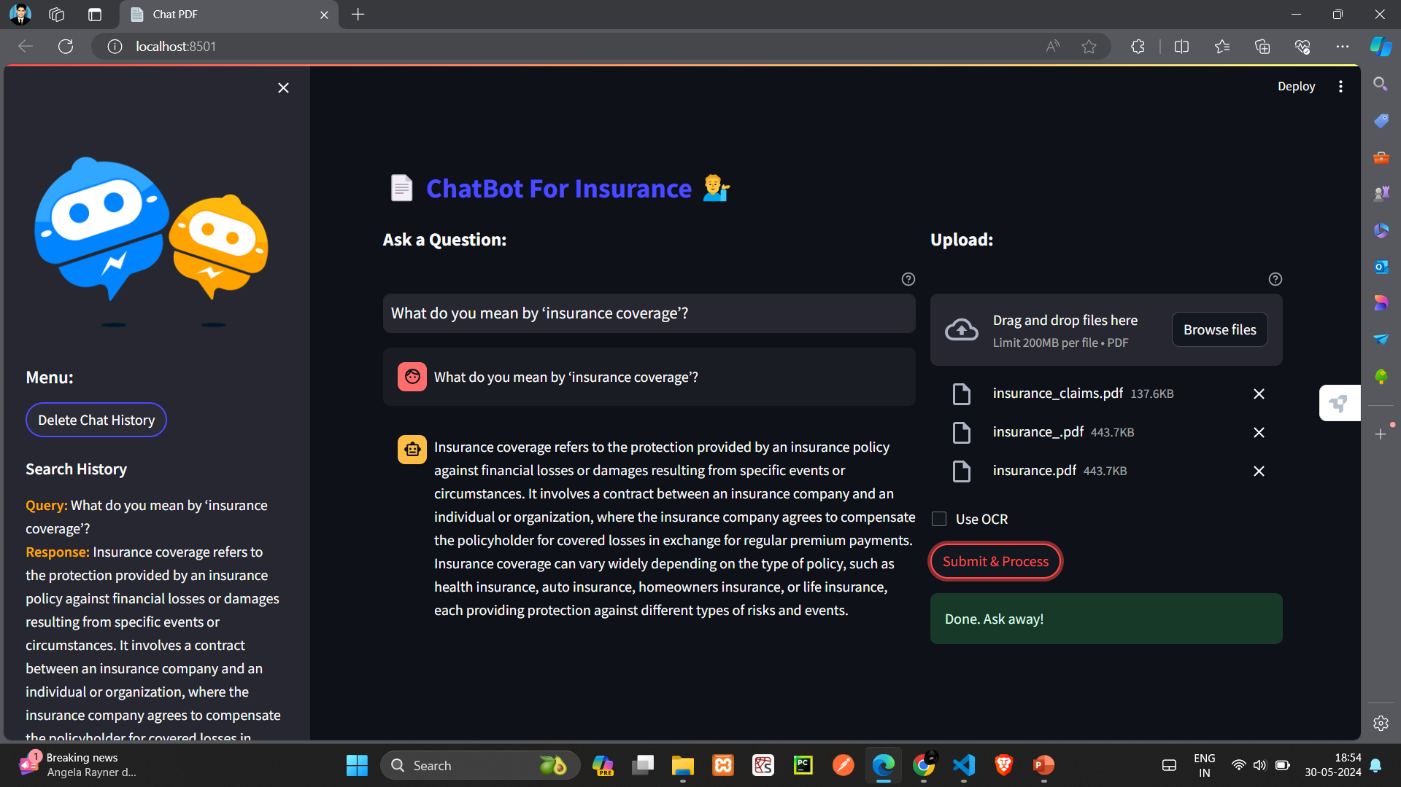
5. Chatbot User Interface (Model Output Screen)
©2024 Benchmark IT Solutions. All rights reserved

Slide 9
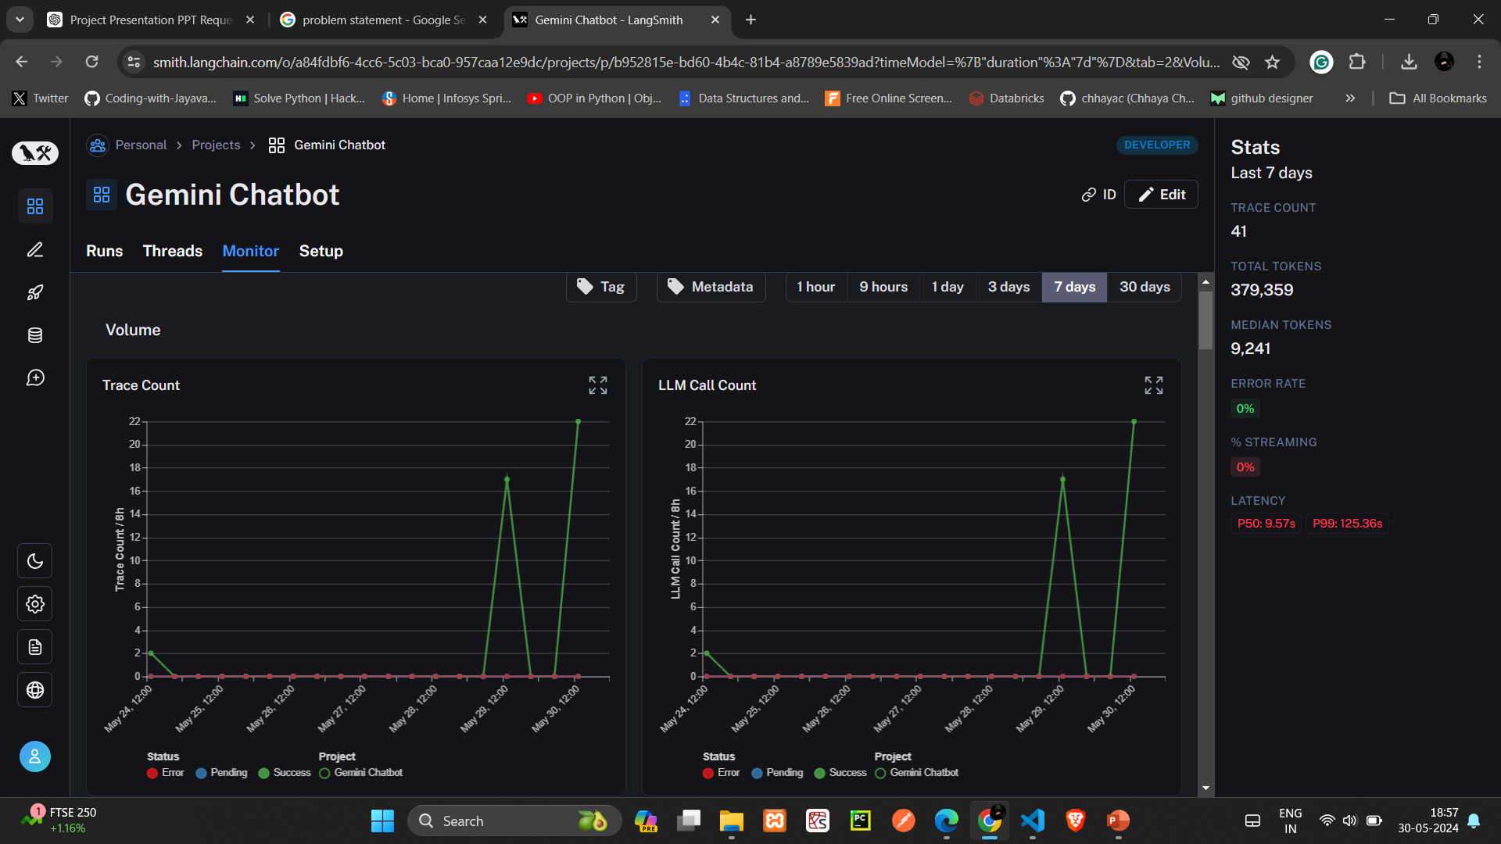
5. LangSmith Monitoring Screen
©2024 Benchmark IT Solutions. All rights reserved

Slide 10
©2024 Benchmark IT Solutions. All rights reserved

